Slide 1
Seq2Seq Results
Put your results from training before and after hyperparameter tuning here.
Results for default configuration using RNN |  | Results for default Configuration Using LSTM
Training Loss | 4.6029 | Training Loss | 3.9919
Training Perplexity | 99.7695 | Training Perplexity | 54.1604
Validation Loss | 4.5198 | Validation Loss | 3.8414
Validation Perplexity | 91.8161 | Validation Perplexity | 46.5884
Result for your Best Model using RNN after hyperparameter tuning |  | Resut for your Best Model using LSTM after hyperparameter tuning
Training Loss | 4.5774 | Training Loss | 3.7886
Training Perplexity | 97.2600 | Training Perplexity | 44.1940
Validation Loss | 4.5545 | Validation Loss | 3.8045
Validation Perplexity | 95.0576 | Validation Perplexity | 44.9035
Your best model configuration for RNN after hyperparameter tuning |  | Your best model configuration for LSTM after hyperparameter tuning
Batch size=64, learning rate = 3e-3, dropout=0.3, epochs=10 |  | Batch size=64, learning rate = 1e-2, Dropout=0.5, epochs=10
Table 1

Slide 2
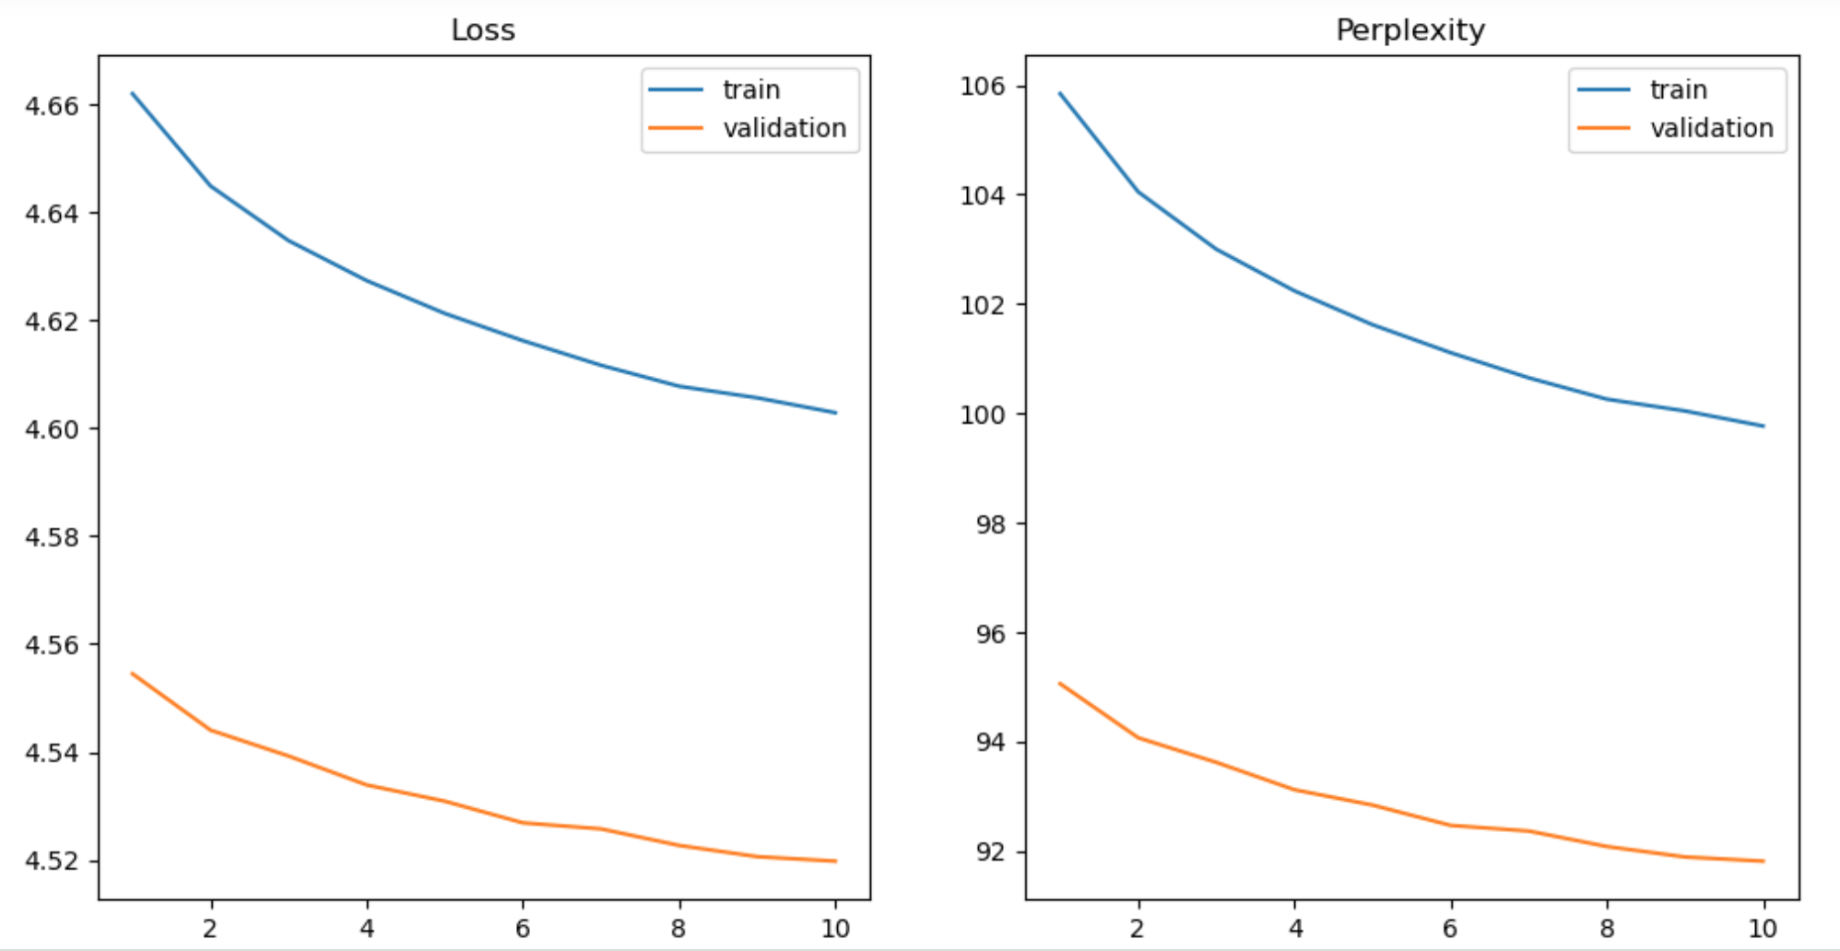
Seq2Seq Curves – RNN Default setting
Put the plots for loss and perplexity curves (training & validation) for your configuration with default setting and for your best model here. Use additional slides as necessary.

Slide 3
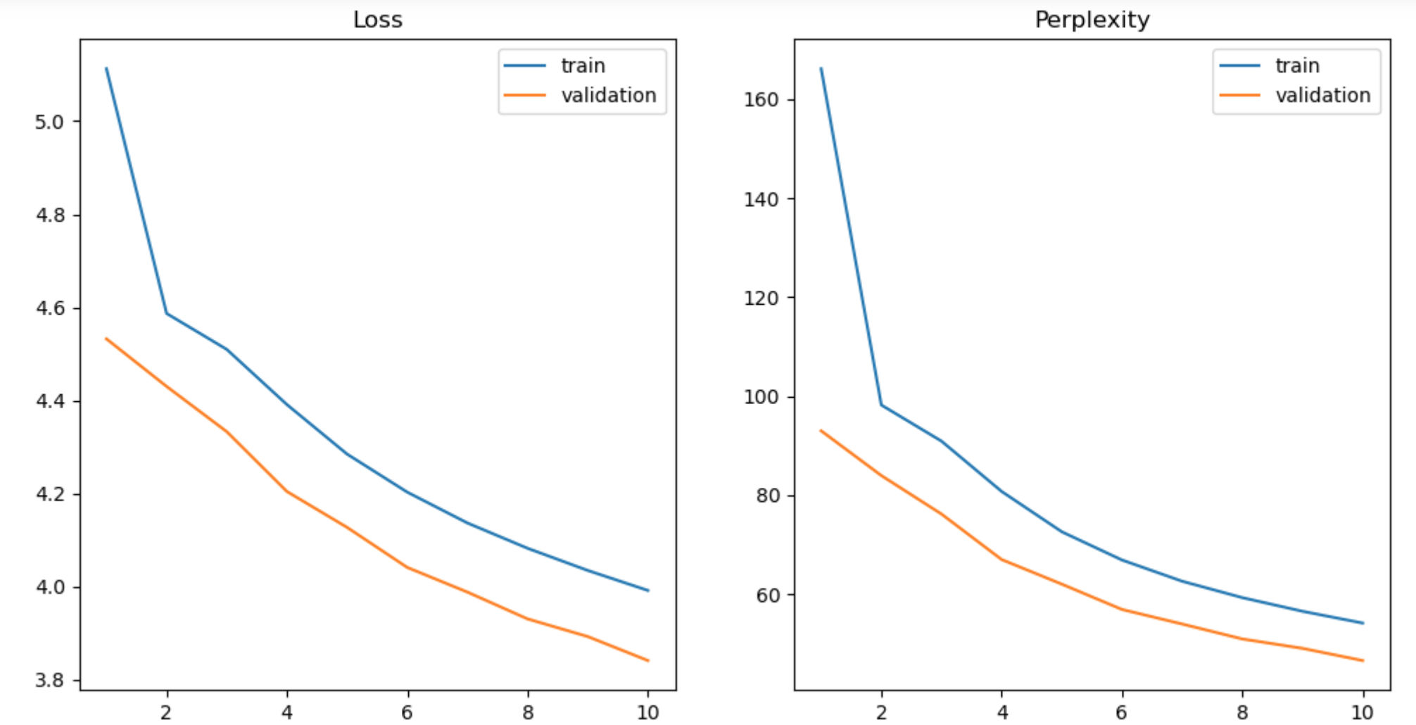
LSTM-DEFAULT SETTING

Slide 4
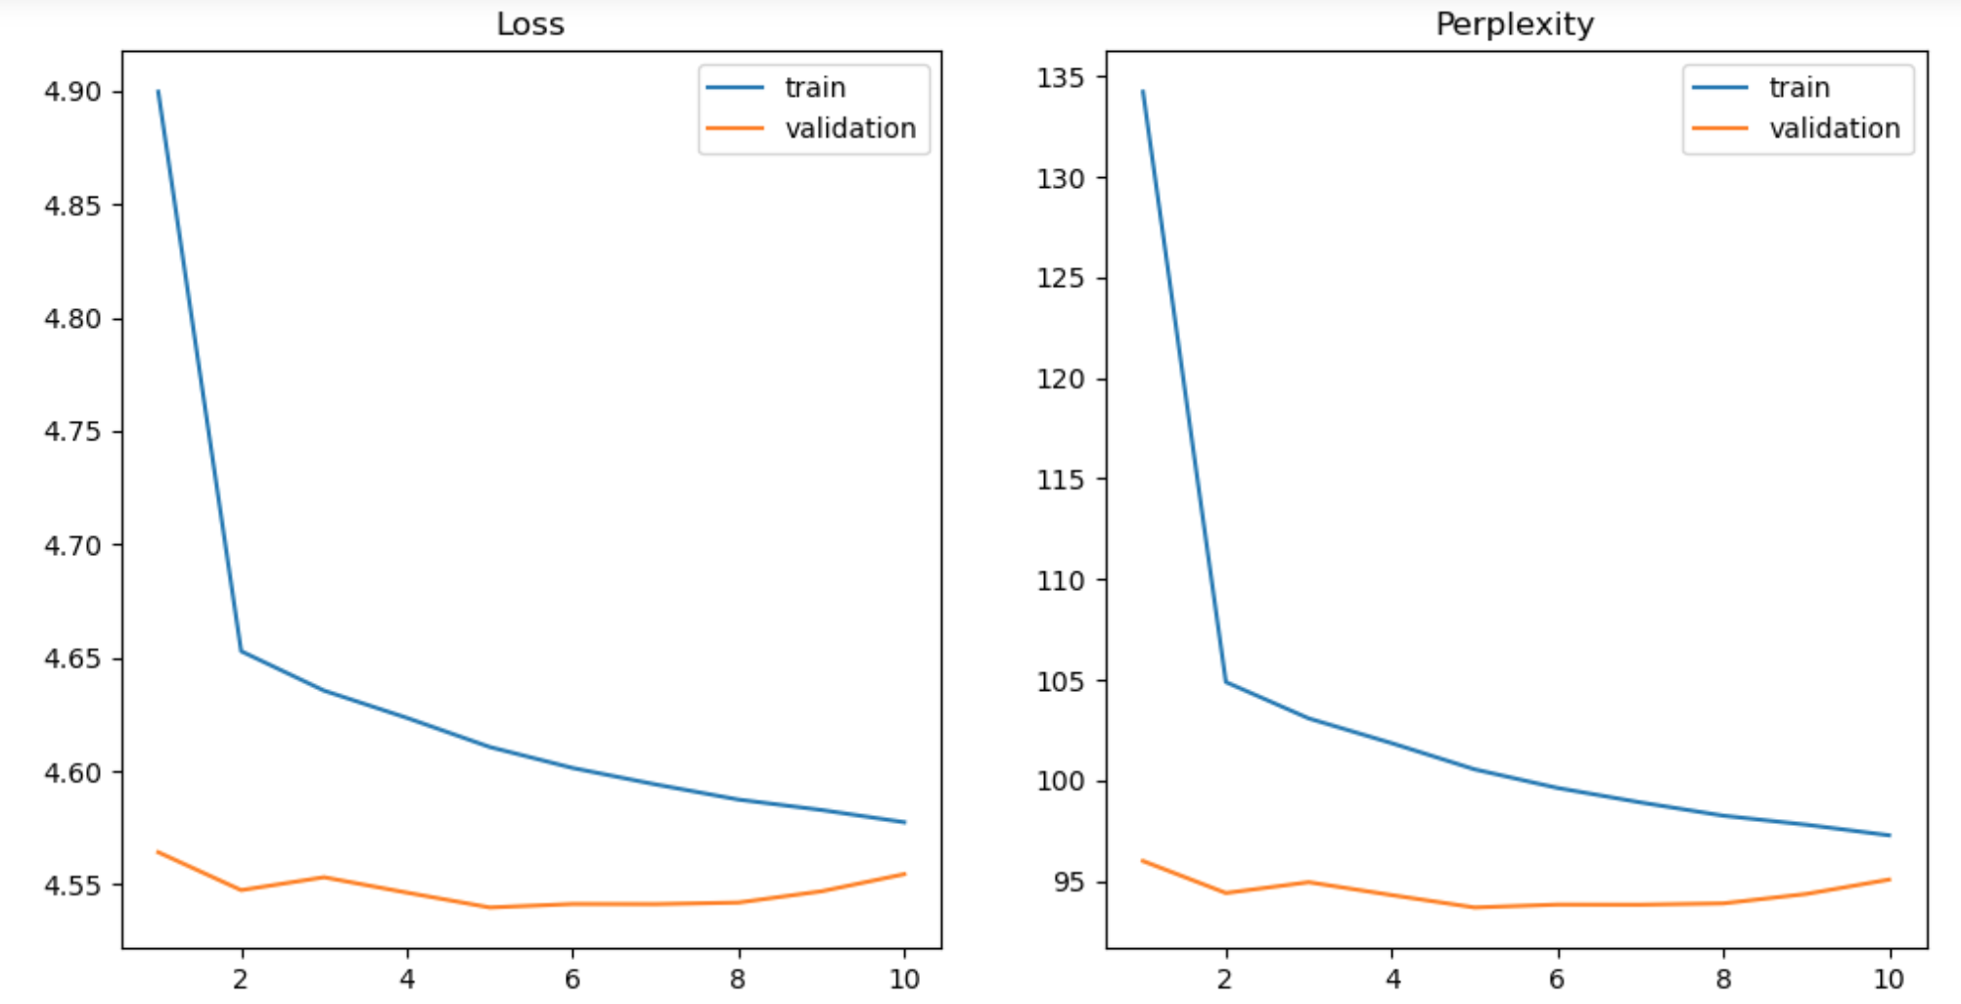
My best model - RNN

Slide 5
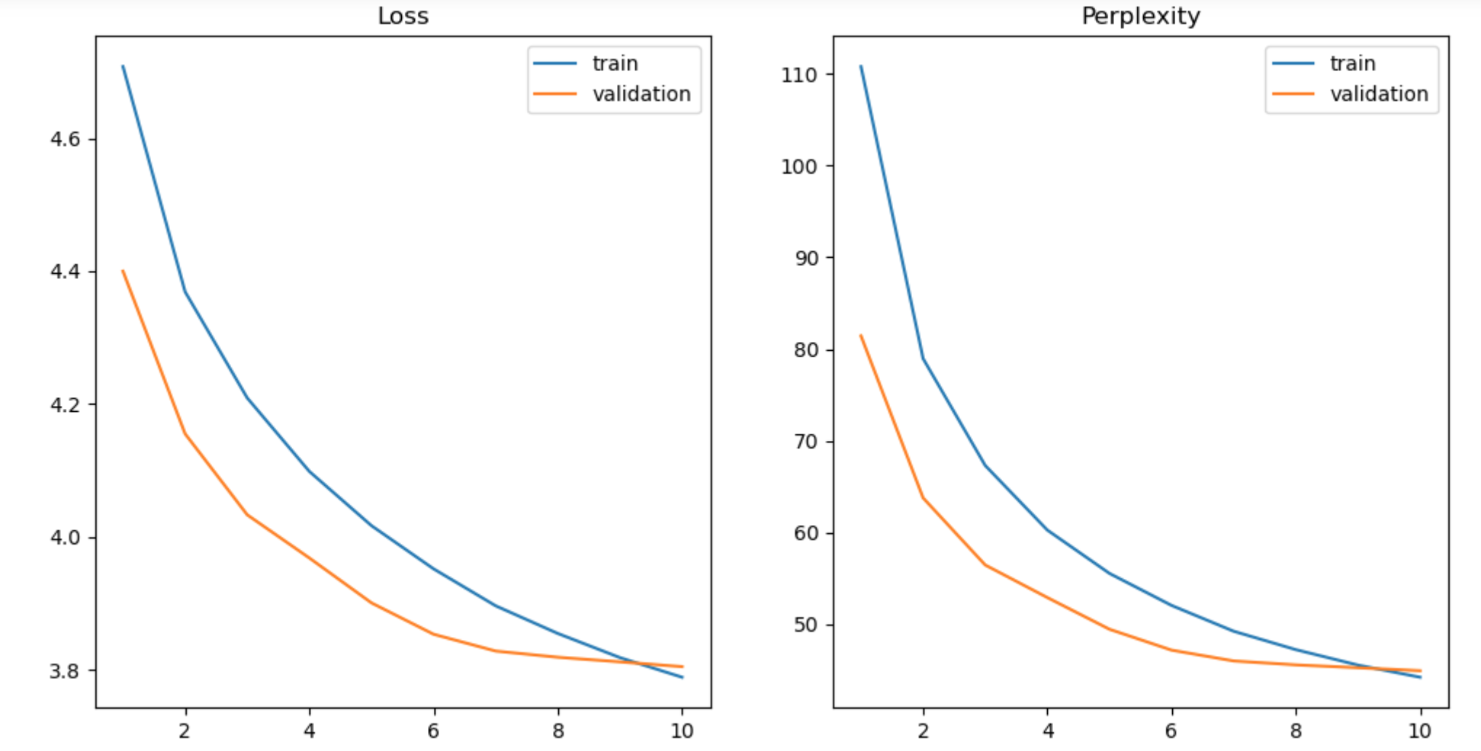
My best model - LSTM

Slide 6
Seq2Seq Explanation
Explain what you did here and why you did it to improve your model performance. Compare and explain the differences when using LSTM vs RNN. You may use another slide if needed.
To improve the performance, I decide to:
increases learning rate to 3e-3 (RNN) and 1e-2 (LSTM) so the model can learn faster.
batch size decreases from 128 to 64, smaller batch size can lead to faster training speed, but not too small that results in stochastic behavior as the gradients fluctuate and changes its direction more often. Smaller batch size may introduce more variance, we slightly increase learning rate for faster training.
dropout rate increase to 0.3 (RNN) and 0.5 (LSTM), dropout can make model more generalizable to items outside of training data, it prevents overfitting by randomly select some items to drop out in a layer.

Slide 7
RNN vs. LSTM comparison:
In general, LSTM exhibits much better performance than RNN, training perplexity of RNN is 99.8, of LSTM is 54.2. Validation also improves, perplexity decreases from 96.8 in RNN to 46.5 in LSTM.
RNN has the problems of vanishing or exploding gradients due to repeated use of same weights in each time step, whereas LSTM alleviates this problem by using cell state. As expected, we observe better overall performance in LSTM, particularly if sequences are long.

Slide 8
Transformer Results
Put your results from training before and after hyperparameter tuning here.
Results for default configuration
Training Loss | 2.3001 | Validation Loss | 2.9713
Training Perplexity | 9.9756 | Validation Perplexity | 19.5172
Result for your Best Model
Training Loss | 2.2522 | Validation Loss | 3.0041
Training Perplexity | 9.5087 | Validation Perplexity | 20.1676
Your best model configuration after hyperparameter tuning
Batch size=64; learning rate = 8e-4; epochs = 10
Table 2

Slide 9
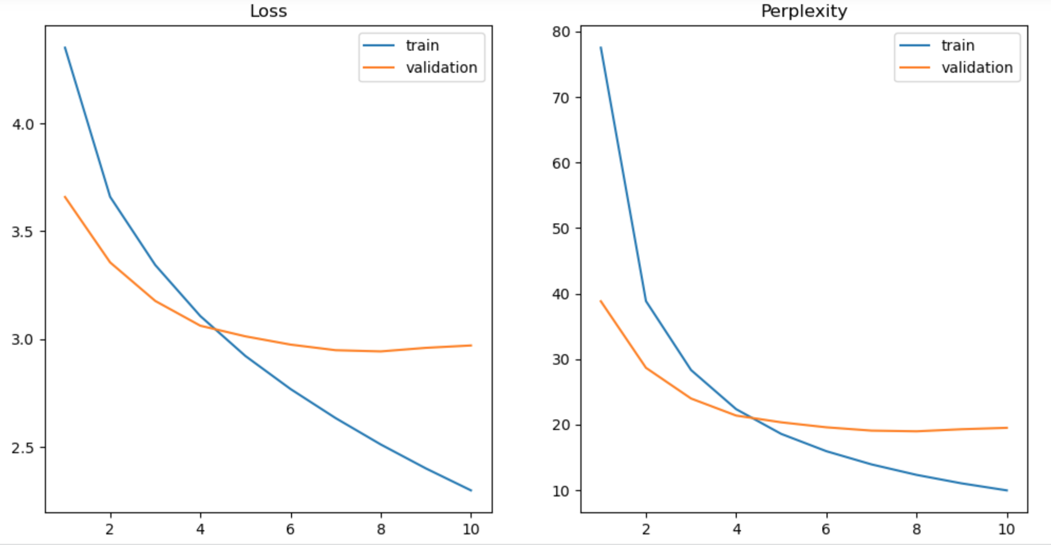
Transformer Curves – Default settings
Put the plots for loss and perplexity curves (training & validation) for your configuration with default setting and for your best model here. You may use additional slides if needed.

Slide 10
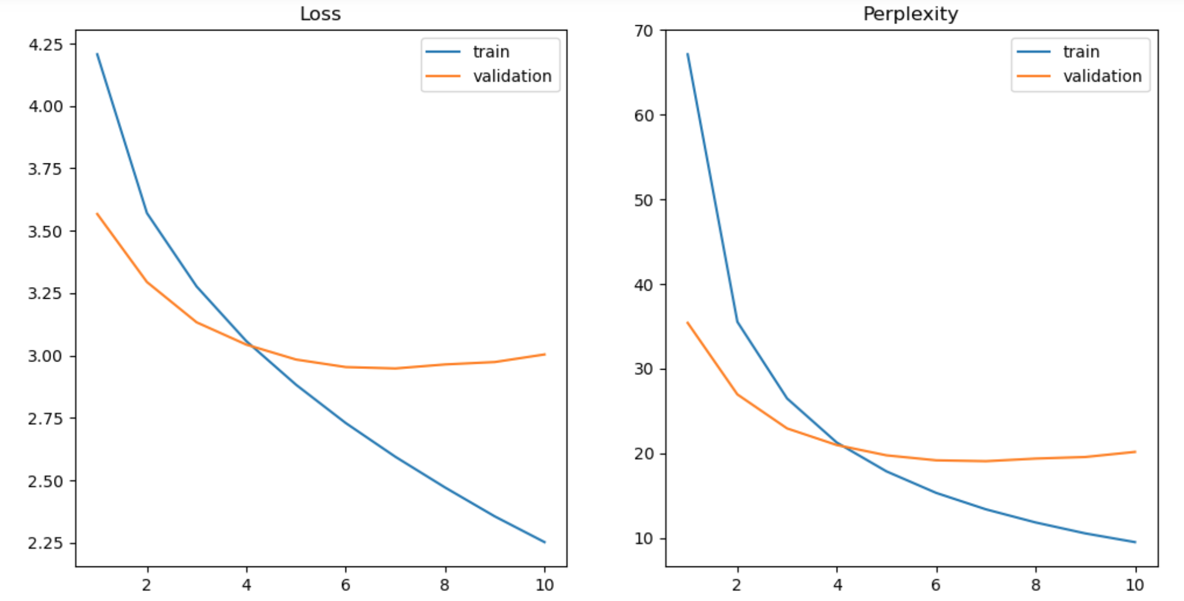
Transformer Curves – My Best Model

Slide 11
Transformer Explanation
Explain what you did here and why you did it to improve your model performance. You may use another slide if needed.
To improve performance, I make following changes:1) learning rate from 1e-4 to 5e-4: to allow faster learning of the model. 2) batch size decreases from 128 to 64: this can introduce slightly more variance into the gradients and allow the model to train faster.

Slide 12
Transformer Translation Results
Put translation results for your best model (1st 9 sentences) here
Input sentence | Back translation
<sos>', 'a', 'young', 'boy', 'jumps', 'into', 'water', '.', '<eos>' | '<sos>', 'a', 'little', 'boy', 'is', 'into', 'into', 'into', '<eos>'
'<sos>', 'a', 'native', 'woman', 'is', 'working', 'on', 'a', 'craft', 'project', '.', '<eos>' | '<sos>', 'a', 'woman', 'is', 'on', 'a', 'a', '.', '.', '<eos>', '<eos>'
'<sos>', 'an', 'asian', 'woman', 'sitting', 'outside', 'an', 'outdoor', 'market', 'stall', '.', '<eos>' | '<sos>', 'an', 'asian', 'asian', 'in', 'in', 'front', 'of', '.', '<eos>',
'<sos>', 'woman', 'standing', 'on', 'a', 'brick', 'wall', 'and', 'taking', 'a', 'picture', '<eos>' | '<sos>', 'woman', 'standing', 'on', 'a', 'brick', 'and', 'at', 'taking', '.', '.', '<eos>'
'<sos>', 'there', 'are', 'construction', 'workers', 'working', 'hard', 'on', 'a', 'project', '.', '<eos>' | '<sos>', 'construction', 'workers', 'workers', 'hard', 'a', 'a', 'a', '.', '.', '<eos>'
'<sos>', 'a', 'man', 'in', 'a', 'cluttered', 'office', 'is', 'using', 'the', 'telephone', '<eos>' | '<sos>', 'a', 'man', 'is', 'at', 'a', 'of', 'office', '.', '.', '.', '<eos>'
'<sos>', 'two', 'chinese', 'people', 'are', 'standing', 'by', 'a', 'chalkboard', '.', '<eos>' | '<sos>', 'two', 'chinese', 'stand', 'standing', 'a', 'a', 'a', '.', '<eos>'
'<sos>', 'children', 'are', 'playing', 'a', 'sport', 'on', 'a', 'field', '.', '<eos>' | '<sos>', 'children', 'are', 'playing', 'playing', 'on', 'a', '.', '.', '<eos>'
'<sos>', 'a', 'man', 'is', 'working', 'at', 'a', 'construction', 'site', '.', '<eos>' | '<sos>', 'a', 'man', 'is', 'working', 'site', 'construction', 'site', 'site', 'site', '<eos>'
Table 3

Slide 13
LSTM Translation Results
Put translation results for your best model (1st 9 sentences) here
Input sentence | Back translation
<sos>', 'a', 'young', 'boy', 'jumps', 'into', 'water', '.', '<eos>' | <sos>', 'a', 'young', 'boy', 'is', 'through', 'the', 'the', '.', '.', '<eos>'
'<sos>', 'a', 'native', 'woman', 'is', 'working', 'on', 'a', 'craft', 'project', '.', '<eos>' | '<sos>', 'a', '<unk>', 'is', 'is', 'a', 'a', 'a', '.', '<eos>'
'<sos>', 'an', 'asian', 'woman', 'sitting', 'outside', 'an', 'outdoor', 'market', 'stall', '.', '<eos>' | '<sos>', 'a', 'young', 'is', 'is', 'a', 'a', 'a', 'a', '.', '<eos>',
'<sos>', 'woman', 'standing', 'on', 'a', 'brick', 'wall', 'and', 'taking', 'a', 'picture', '<eos>' | '<sos>', 'the', 'man', 'is', 'a', 'a', 'a', 'a', 'a', '.', '.', '<eos>'
'<sos>', 'there', 'are', 'construction', 'workers', 'working', 'hard', 'on', 'a', 'project', '.', '<eos>' | <sos>', 'people', 'are', 'are', 'a', 'a', 'a', '.', '.', '<eos>'
'<sos>', 'a', 'man', 'in', 'a', 'cluttered', 'office', 'is', 'using', 'the', 'telephone', '<eos>' | '<sos>', 'a', 'man', 'is', 'standing', 'a', 'a', 'a', '.', '.', '<eos>'
'<sos>', 'two', 'chinese', 'people', 'are', 'standing', 'by', 'a', 'chalkboard', '.', '<eos>' | '<sos>', 'two', 'men', 'are', 'at', 'a', 'a', '.', '<eos>', '<eos>'
'<sos>', 'children', 'are', 'playing', 'a', 'sport', 'on', 'a', 'field', '.', '<eos>' | '<sos>', 'children', 'are', 'playing', 'a', 'a', 'a', '.', '.', '<eos>'
'<sos>', 'a', 'man', 'is', 'working', 'at', 'a', 'construction', 'site', '.', '<eos>' | <sos>', 'a', 'man', 'is', 'a', 'a', 'a', 'a', '.', '<eos>',
Table 4

Slide 14
Compare LSTM to Transformer
In our sample, Transformer outperforms LSTM:
1) LSTM produces fewer (2 to 3 words) matched key words, and only in early stage of sentences, while more key words (5 to 7 words) match up in Tranformer model.
2) LSTM only appears effective in early stage (the first 2-3 words), Transformers consistently perform regardless of sequence order.
3) Transformer model obtains better accuracy overall, especially better than LSTM in late sequence.
Those advantages of Transformers are related to the fact that Transformer takes a holistic non-sequential approach to process the input sequence while LSTM is sequential. Besides, Transformer introduces self-attention which captures the contextual information of each input, across the whole input sentence. In conly captures information prior to the current ontrast, LSTM hidden states one.

Slide 15
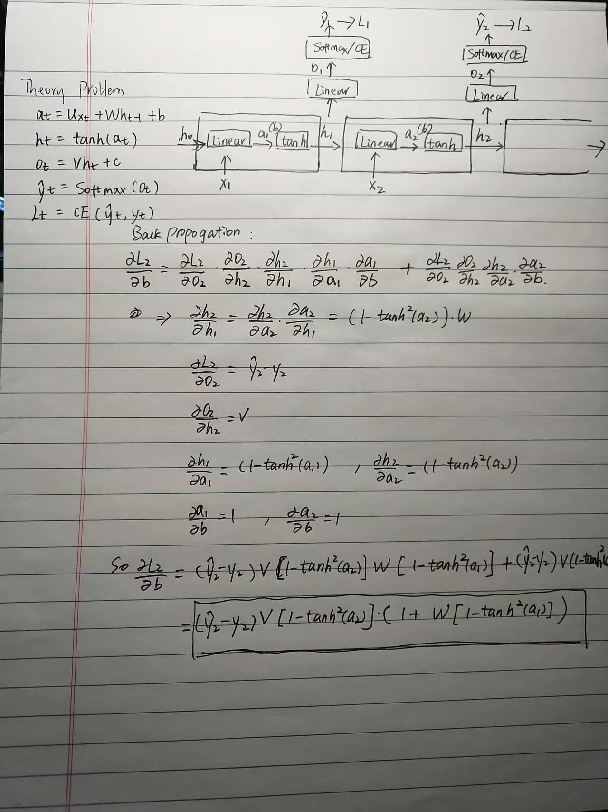
Theory question
Add additional slides as necessary for your answer

Slide 16
Paper discussion
Paper 1: Do vision transformers see like CNNs?
This paper investigates the ways that ViT performs image classification tasks and compare it to CNNs. Through multiple experiments, the paper shows substantial differences between ViT and CNNs, from feature representation, , spatial information, to sample size requirements.
One advantages of the study is the clean visual presentation to present the architecture difference between the two models. However, the paper also suffers from scattered information, without a systematic organization.
Open questions left to be addressed in future research: as shown in Figure 2, only early layers of ViT pertains some similarities to CNNs, ViT eventually learned some qualitatively different and additional features in higher layers. It remains to be studied that what those additional learned features are and what they do in ViT.

Slide 17
Question 1
.
Comparing the learned features of ViT and CNNs, the paper finds:1) ViT are uniform in feature representation across layers, while CNNs feature representation are heterogeneous across low and high layers. 2)ViT learned similar features as CNNs in early layers, but also learned additional and different features in higher layers.
Those feature differences exist because 1) self-attention in ViT enables early aggregation of global information, while CNNs mostly attend to local receptive fields. 2) In term of network architecture, ViT residual connections help to propagate features from lower to higher layers.

Slide 18
Question 2
Spatial localization refers to the ability to preserve spatial information from input to higher layers of a model.
Why ViT better for object detection? The paper shows that ViTs successfully preserve input spatial information (if using CLS), and higher layers of ViT maintain spatial local information more faithfully than CNNs. Hence, ViT is a good candidate for object detection

